Slide 1
Introduction To GTest
C Unit Testing

Slide 2
Unit Testing
With Google Test

Slide 3
Why Google Test
Google Test is designed to be portable
You can decide which tests to run using name patterns
Google Test can generate XML test result reports
Easy to write assertions that generate informative messages
Google Test automatically detects your tests and doesn't require you to enumerate them in order to run them

Slide 4
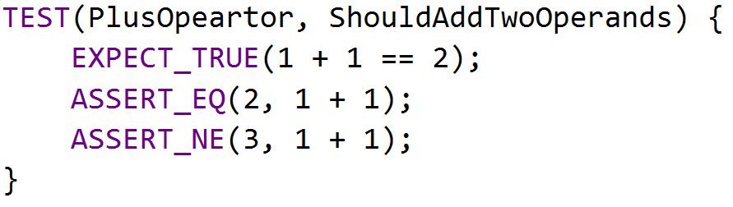
BASIC CONCEPTS
Start by writing assertions. An assertion's result can be success, nonfatal failure, or fatal failure

Slide 5
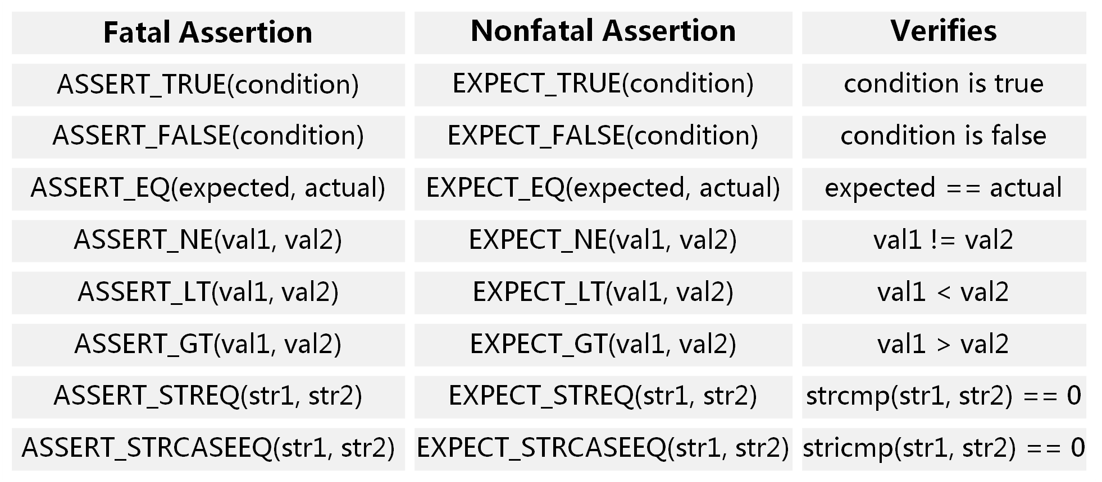
ASSERTIONS
EXPECT_* generate nonfatal failures, which don't abort the current function
ASSERT_* generate fatal failures when they fail, and abort the current function

Slide 6
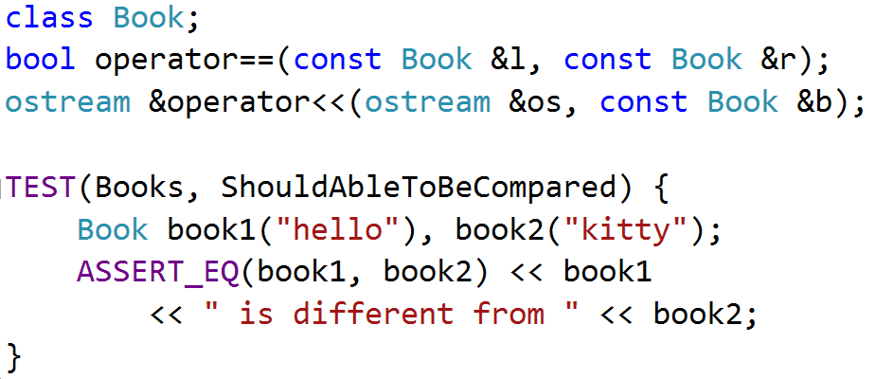
Requirement
Value arguments must be comparable by the assertion's comparison operator
Values must support the << operator for streaming to an std::ostream

Slide 7
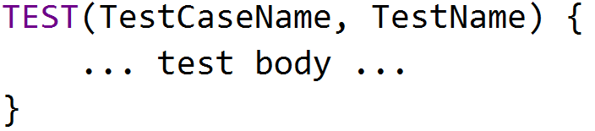
TEST STRUCTURE
Test Program
Test Case
Test Case
Test
Test
Test
Test
Test
Test
Test

Slide 8
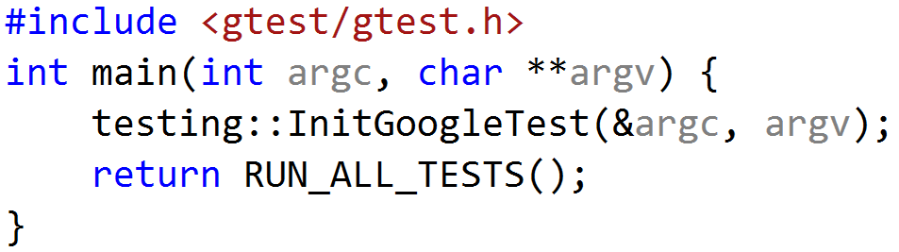
USING GTEST
include <gtest/gtest.h>
write your tests in any source files
initialize gtest by InitGoogleTest()
call RUN_ALL_TESTS() in main() function
compile and run

Slide 9
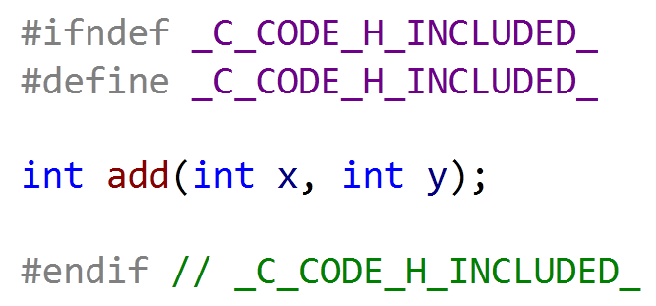
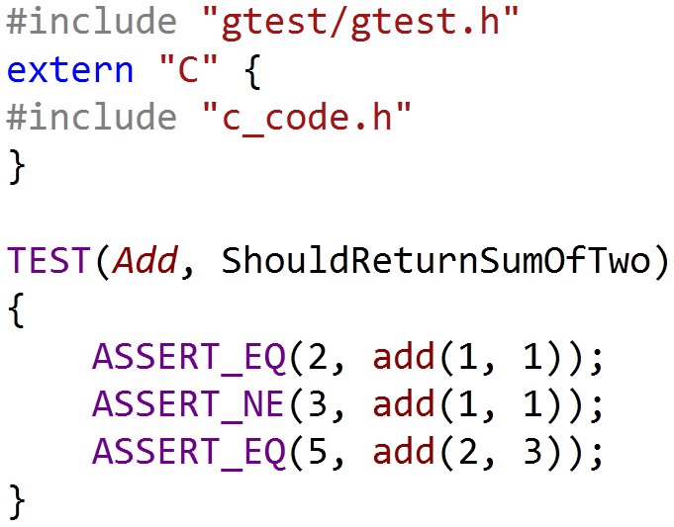
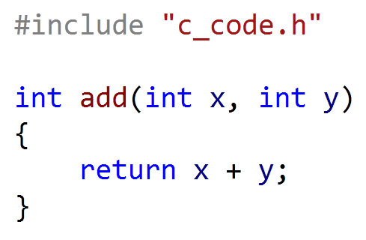
Working With C Code
Wrap C headers with extern“C”
c_code.h
c_code_test.cpp
include
c_code.c
link
$ objdump -t c.o cpp.o
c.o SYMBOL TABLE:
F .text 0000000000000014 add
cpp.o SYMBOL TABLE:
F .text 0000000000000014 _Z3addii

Slide 10

EXERCISE
你是一名体育老师，在某次课距离下课还有五分钟时，你决定搞一个游戏。此时有100名学生在上课。游戏的规则是：
你首先说出三个不同的特殊数，要求必须是个位数，比如3、5、7。之后所有学生拍成一队，然后按顺序报数。
学生报数时，如果所报数字是第一个特殊数（3）的倍数，那么不能说该数字，而要说Fizz；如果所报数字是第二个特殊数（5）的倍数，那么要说Buzz；如果所报数字是第三个特殊数（7）的倍数，那么要说Whizz。

Slide 11
TO DO
通过SSH登录10.249.253.46
username: training
password: training
进入home目录下自己名字对应的目录
进入ut-01-fizz-game目录
完成题目需求并运行测试
编译: make all
测试: make test

Slide 12
Test-Driven Development

Slide 13
EXERCISE
学生报数时，如果所报数字同时是两个特殊数的倍数情况下，也要特殊处理，比如第一个特殊数和第二个特殊数的倍数，那么不能说该数字，而是要说FizzBuzz, 以此类推。如果同时是三个特殊数的倍数，那么要说FizzBuzzWhizz。
学生报数时，如果所报数字包含了第一个特殊数，那么也不能说该数字，而是要说相应的单词，比如本例中第一个特殊数是3，那么要报13的同学应该说Fizz。如果数字中包含了第一个特殊数，那么忽略规则3和规则4，比如要报35的同学只报Fizz，不报BuzzWhizz。

Slide 14
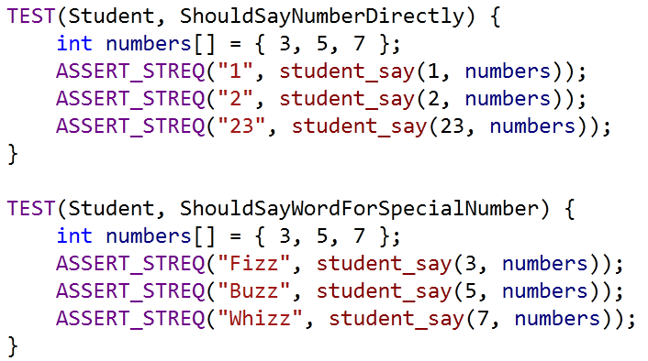
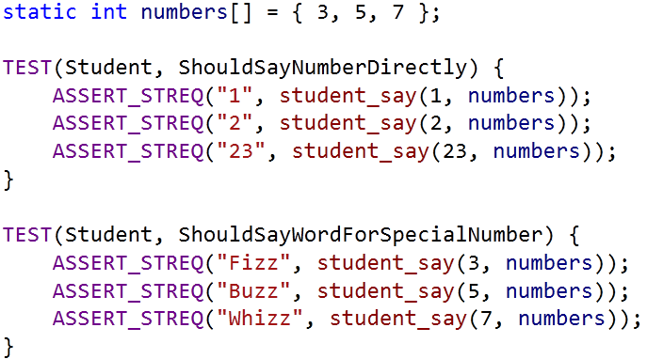
Shared Variables
Shared Variables
Shared Variables need to be cleaned up
Shared variables may be changed in test cases

Slide 15
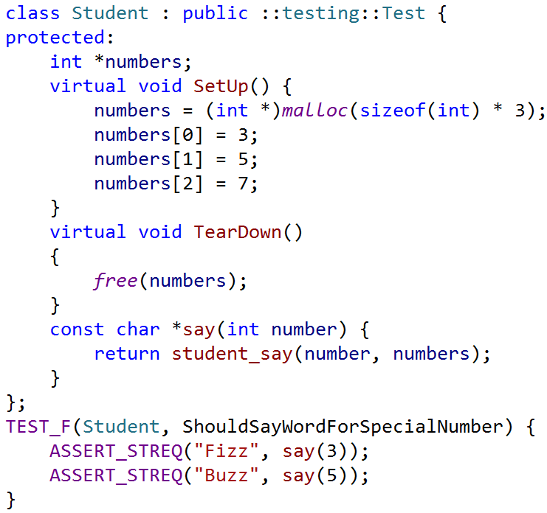
TEST Fixture
A test fixture allows you to reuse the same configuration of objects for several different tests
Shared Variables
Prepare Test Data
Clean Up Environment
Helper Functions

Slide 16
TEST FIXTURE Internals
Google Test constructs a Student object (let's call it t1 ).
t1.SetUp() initializes t1 .
the test(ShouldSayWordForSpecialNumber) runs on t1.
t1.TearDown() cleans up after the test finishes.
t1 is destructed.
SetUp() & TearDown() will be executed for each test

Slide 17
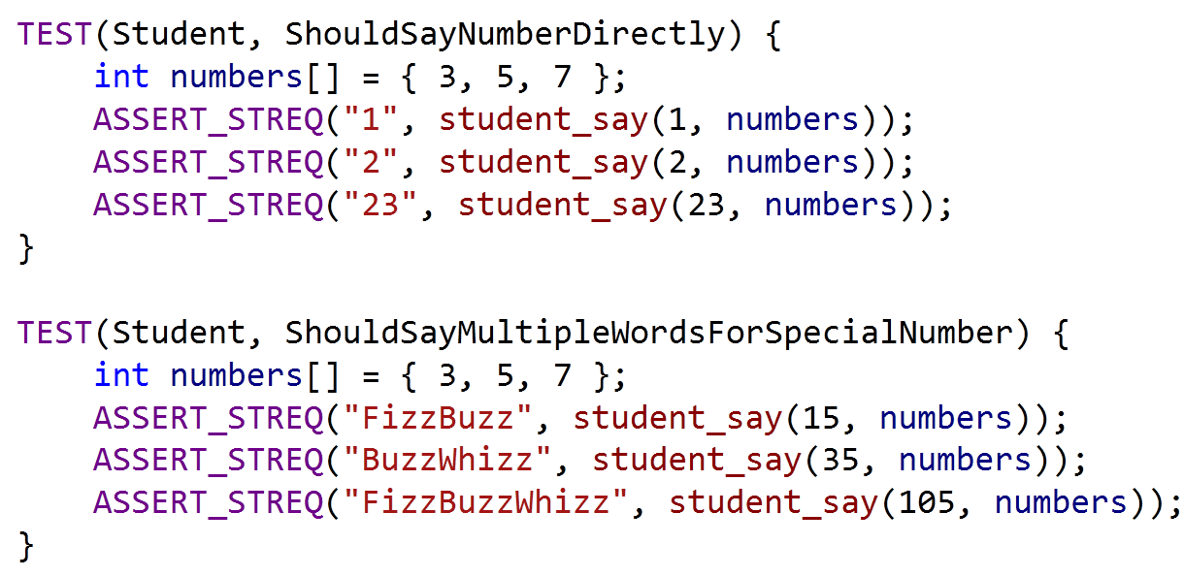
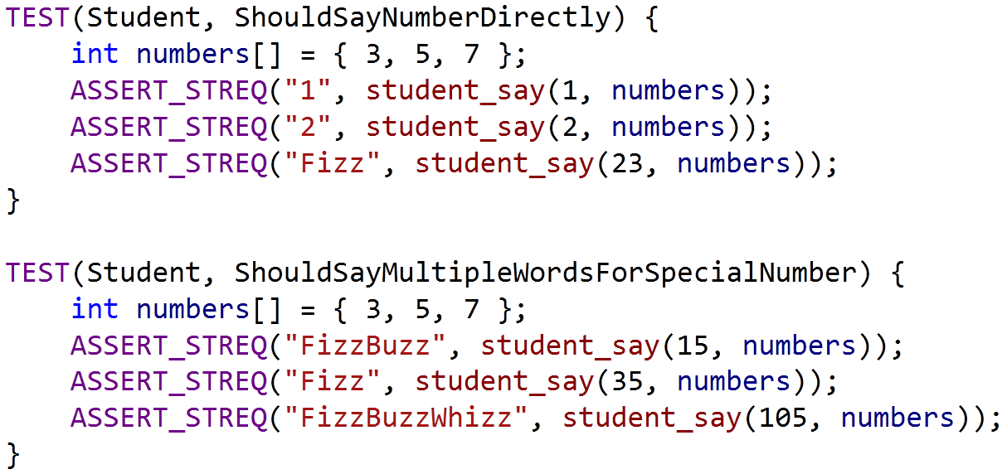
Test Case Issues
Notes:
新增需求导致老的测试需要修改

Slide 18

Single RESPONSIBILITY PRINCPILE

Slide 19
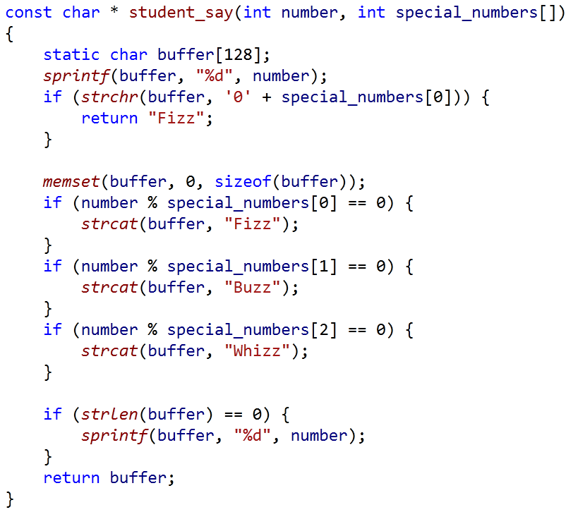
Responsibility of Student
Special Word Rule
Multiple Rule
Default Rule

Slide 20
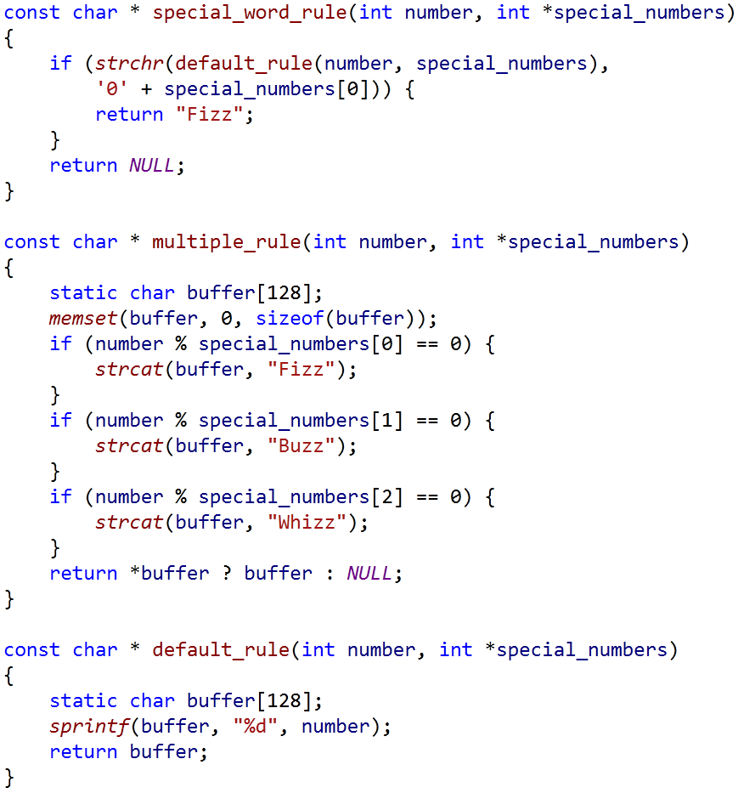
Extracting Rules
Special Word Rule
Multiple Rule
Default Rule

Slide 21
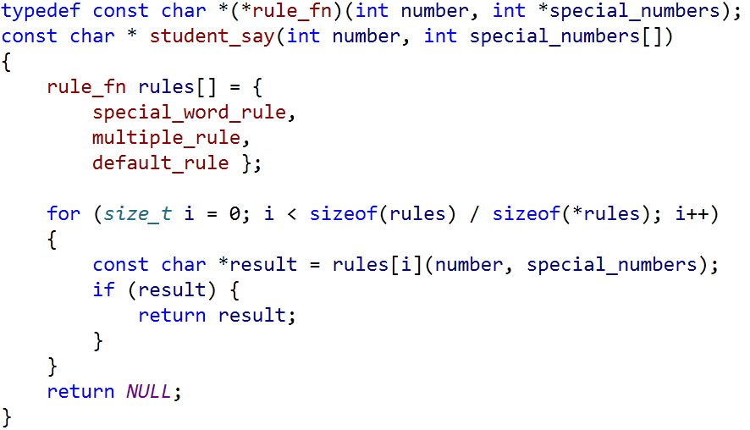
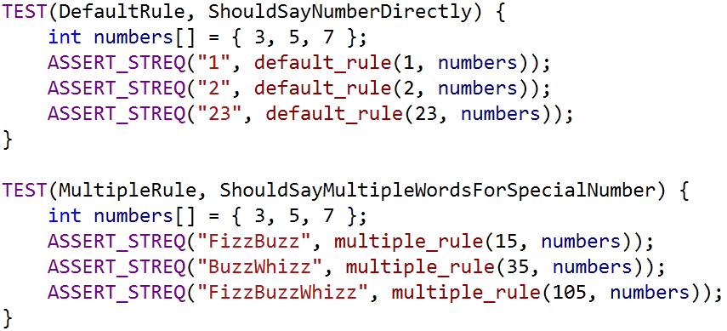
Applying Rules
Game Rules

Slide 22
EXERCISE
重构student_say()的实现, 并针对不同规则进行测试
通过Test Fixture重构测试用例(bonus)

Slide 23

After Refactoring
Game Rules
How To Test student_say()

Slide 24
Reference
https://code.google.com/p/googletest/wiki/Primer
https://code.google.com/p/googletest/wiki/AdvancedGuide
https://code.google.com/p/googletest/wiki/FAQ
《测试驱动开发》

Slide 25
Q & A

Slide 26
THANK YOU
For questions or suggestions:
Wu Kun
kunwu@thoughtworks.com

